Slide 1
Universal Design for Learning and Accessibility Considerations
Ivan Chow, Instructional Designer, Rotman Digital
ivan.chow@rotman.utoronto.ca

Slide 2
Summary
What is Universal Design for Learning (UDL)?
The three UDL principles
How do I incorporate UDL in my pedagogy?
The +1 method
Is this more work for me as the instructor?
Tools for creating accessible course content
Notes:
https://udlguidelines.cast.org

Slide 3
1.1. What is Universal Design for Learning (UDL)?
Universal Design for Learning (UDL) is an evidence-based framework informed by cognitive and learning science that supports different learner needs.
Developed by David Rose at Harvard in the 1990s
Actively supported by CAST (The Center for Applied Special Technology)
Reach everyone, teach everyone (Thomas J. Tobin and Kirsten T. Behling, 2018)

Slide 4
1.2. The three UDL principles
Engagement
Learners are given multiple means to engage with the material, concepts, or course to motivate learning
Representation
Provide course content to learners in different ways
Action and Expression
Learners are given multiple ways to express and demonstrate what they have learned

Slide 5
1.2.1. Engagement (The Why of Learning)
Provide options for…
recruiting interest
Choice and autonomy, contextualizing, relevance
sustaining effort and persistence
Learning activities, collaboration and community
self-regulation
Assess mastery of skills/concepts

Slide 6
1.2.2. Representation (The What of Learning)
Provide options for…
perception
Multiple modalities
Example: Summary video on History of the English language
language & symbols
Break language barriers, clarify key terms, mathematical expressions, and symbol
comprehension
Background knowledge, patterns, critical features, big ideas, relationships

Slide 7
1.2.3. Action and Expression (The How of Learning)
Provide options for…
physical action
Response methods, tools and assistive technologies
expression and communication
Multimedia communication, scaffolding
executive functions
Goals, milestones, learning strategies

Slide 8
2.1. How do I incorporate UDL in my pedagogy?
Use the +1 method (Reach Everyone, Teach Everyone – T. Tobin & K. Behling)
“you can add one new way of engagement, representation, or action and expression every semester you teach your course so that eventually your course has more UDL elements”
The UDL Guidelines
UDL on Campus

Slide 9
2.2. How do I incorporate UDL in my pedagogy?
Examples of +1
Add multimodality to the course content
a video, an audio clip, infographics, or anything that can supplement textual delivery
Add choices to your assessments
different questions to choose from in an assignment
different ways learners can submit their work (essay, podcast, video, etc.) while still attaining the same
learning objectives

Slide 10
3. Is this more work for me as the instructor?
NO! You are doing it already!
Example: when presenting the idea of calculating “future value” in a finance course
Do I have to implement ALL the principles and items in the UDL guideline?
NO! Being mindful of the UDL principles when you design your course is a good start.
If you’re up for it, try 1 or 2 new things: the key is NOT to overwhelm yourself!

Slide 11
4. Tools for creating accessible course content
Multimedia Accessibility
Generating closed captions with MS Stream
Uploading videos and VTT files to MyMedia
Uploading transcripts to Quercus
For assistance
rotmandigital@rotman.utoronto.ca

Slide 12
4. Tools for creating accessible course content
Making course documents accessible
Microsoft Office: select Review > Check Accessibility
Understanding Document Accessibility (Digital Education Strategies, The Chang School, Ryerson University)
Accessibility Toolkit 2nd Edition (BC Campus)

Slide 13
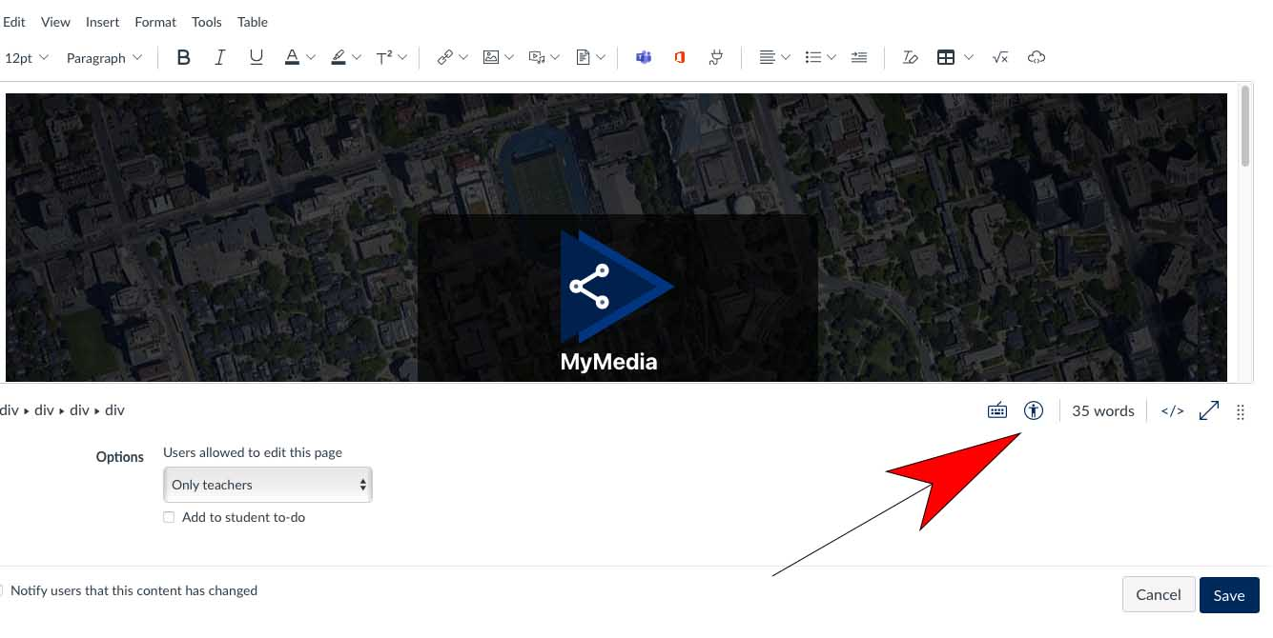
4. Tools for creating accessible course content
Quercus
Accessibility Check button – bottom-right of page editor

Slide 14
Recap
What is Universal Design for Learning (UDL)?
The three UDL principles
How do I incorporate UDL in my pedagogy?
The +1 method
Is this more work for me as the instructor?
Tools for creating accessible course content

Slide 15
Activity
What is your take-away message from this webinar?
Please type a one-sentence answer in the chat

Slide 16
Activity
What is the muddiest point in this presentation / on which topic would you like further clarification?
Please type a one-sentence answer in the chat

Slide 17
Questions?
Instructional design support:
ivan.chow@rotman.utoronto.ca
Educational technology support:
rotmandigital@rotman.utoronto.ca

