Slide 1
VALUE CREATION & EXCHANGE: PART 1
Understanding Utility & Value Propositions
© 2021 Bill McConkey, Sarah Shujah, Danielle Moed, Al Hearn, and Dave Fenton.
This work is licensed under a Creative Commons Attribution-NonCommercial-ShareAlike 4.0 International License.

Slide 2
VALUE
1: the monetary worth of something : market price
2: a fair return or equivalent in goods, services or money for something exchanged
3: relative worth, utility, or importance:
// a good value at the price
// the value of base stealing in baseball
// had nothing of value to say
4: something (such as a principle or quality) intrinsically valuable or desirable
// sought material values instead of
human values — W. H. Jones”
(Merriam Webster, 2021)

Slide 3
What is utility?
Example: The Car
INHERENT/OBJECTIVE/BUILT-IN UTILITY
A car is able to drive.
SUBJECTIVE UTILITY
The need of a car can vary between people, or some people like cars more than others.

Slide 4
Reflection #1
Exploring Utility
Use your personal notebook for this activity.
This exercise will help you explore the inherent built-in utility of your own product or service.
BRAINSTORM
Think about your idea whether it’s a product or service.
1. What is the inherent built-in utility?
2. What are some subjective utilities?

Slide 5
Categories of Utility
FORM UTILITY
PLACE UTILITY
TIME UTILITY
How does the shape and other ‘form factors’ of the product provide utility?
Location for the purchase and/or consumption of the product or service adds ease, comfort or other utility.
Availability and efficiency of access to the product or service connects favourably with consumers’ schedules.
ACCESS UTILITY
KNOWLEDGE UTILITY
Previously called ownership utility – describes the benefit of knowing a resource is available for your use when and where you want it.
Readily available and understandable information that helps you to know how, when and why the product/service would be of use.

Slide 6
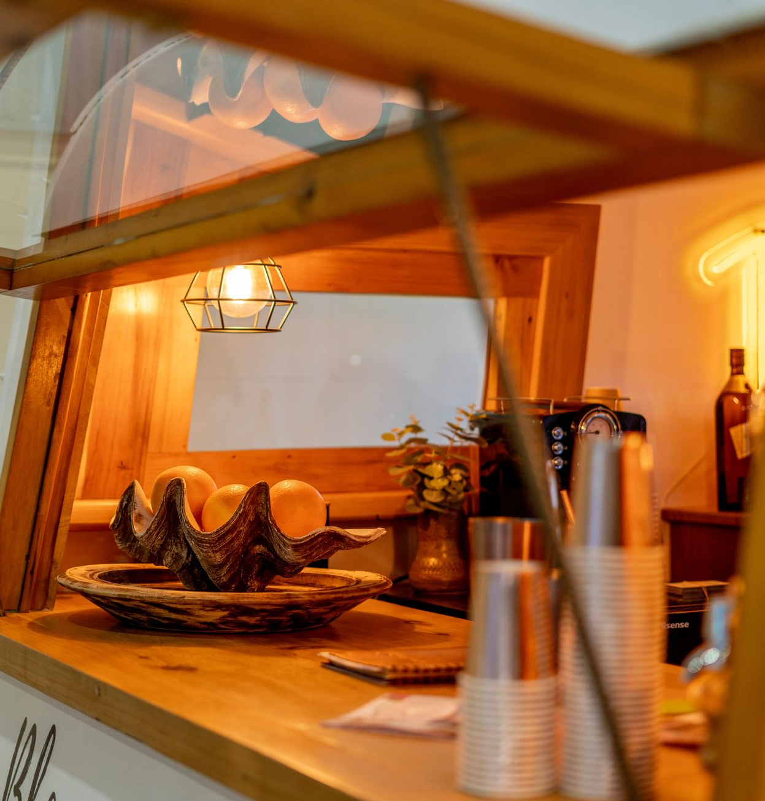
Example of Utility
Bakery During COVID-19
Small independently owned bakery
Government and public health implements COVID-19 business restrictions
ACTION
RESULT
Installed a walk-up window at store front
Customers can safely and within public health protocols continue to purchase coffee, treats, and food using service window
No reduction in revenue and business can continue to operate

Slide 7
Reflection #2
Examining Categories of Utility
Use your personal notebook for this activity. This exercise will help you examine categories of utility, their value and how the categories of utility might be designed to provide improved utility.
Consider...
STEP 1: BRAINSTORM
STEP 2: ANALYSIS
Is there a knowledge utility missing from this list?
When someone visits their bank's website:
1. What are the forms of utility that they might expect to receive?
2. What value do you place on each one?
3. Why?
Pick one of these forms of utility and explain how you might have designed it differently in order to provide more utility.
If so, why is it valuable to you and where would you rank it?

Slide 8
What is a Value Proposition?
What value does your product/service provide?
To whom does your product/service provide value?
UTILITY
Tip
Characteristic of the product or service
Objective
Learn more about your target audience/ customer through primary and secondary research with our Entrepreneurship Research 101 modules.
VALUE
Perception of importance of product/service utility by each consumer
Subjective

Slide 9
Value Proposition: Emotional Impact
Conventional usefulness versus value as a function of affect.
How does the product or service make you feel?
EXAMPLE: AMUSEMENT PARK
VALUE
Little conventional usefulness, yet how do you feel on a roller coaster?
Excitement, thrill
Type text
FORM & PLACE UTILITY
What’s the emotional experience you get from going to the amusement park?
Fun, stress reduction, connection with whom you go with

Slide 10
Example Bakery During COVID-19
Value Proposition & Emotional Impact
USEFULNESS
EMOTIONAL
Knowledge Utility: Communicated new delivery system in a novel way
Access Utility: Continued to provide access to services while being COVID-19 safe
Form Utility: Changed delivery mechanism through the physical form of installing a service window
Sense of Community: Connecting with people at the bakery or in the line
Sense of Nostalgia: Through taste of food and music
Feelings: Joy/happiness from the yummy treats and drinks
Aesthetic: Colour or style of packing provides an emotional response

Slide 11
Reflection #3
Value Proposition: Function & Feel
Use your personal notebook for this activity.
This exercise will help you examine the function of your own idea and feelings it may evoke.
Reflect back...
Review your response to Reflection #1 before completing this activity.
BRAINSTORM
Consider the function of your idea and the feelings it may evoke (or elaborate on the bakery as an example).
1. How does this product/service make people feel?
2. Considering the overall design of this product/service, is there an emotional experience or element to your product/service?
Next Step
Value Creation and
Exchange Part 2

Slide 12
1
CONTACT YOUR BUSINESS LIBRARIAN
3
TAKE OTHER MODULES
Value Creation & Exchange: Part 2
Entrepreneurship Research 101: Part 1
Entrepreneurship Research 101: Part 2
Self-Assessment: Are you an Entrepreneur?
Access proprietary resources to find industry information, reports and statistics.
For U of T book a research consultation
Next Steps
& Summary
2
EXPLORE MORE RESOURCES
Articulate the utility and value of your product/service to establish your success
The BRIDGE's New Venture Program Library Guide
University of Toronto Entrepreneurship Library Guide

